Slide 1


IWD- Redefine Possible Capstone Project :
Data Analytics Track
Linkedin Job Market Analysis
Presented by: M.AbdelGawad

Slide 2
Today's Agenda
Data Challenges
Dashboard
Missing
Work Types
Key Dashboard Elements
Project Objective
Data Cleaning

Slide 3
Project Objective
To analyze job listings from LinkedIn in order to understand the distribution of roles, companies, work types, and countries hiring for data-related positions.
Key Questions :
What are the most in-demand job titles in the data field ?
Which companies and countries are hiring the most ?
What types of employment and work arrangements are offered ?
This analysis aims to support job seekers, HR teams, and career advisors by providing insights into the current data job market.

Slide 4
Data Challenges
- Missing Values:
work_type and employment_type were completely empty.
- Non-standard Locations:
"New York, NY" — country name not directly available
- Unstructured Job Descriptions:
Descriptions were long and unstructured.

Slide 5
Data Cleaning
Missing Work Type & Employment Type
Solution : Used the job link column to perform additional web scraping using Seleinum .
Visited each job URL and extracted the missing values from the original LinkedIn page.
Unstructured Job Titles
Solution : Standardized job titles into broader categories (e.g., Data Analyst, Data Scientist)
for consistency.
Non-standard Location Format
Solution : Created a Python dictionary to map each location to its corresponding country.
This enabled consistent geographic grouping in the dashboard.

Slide 6
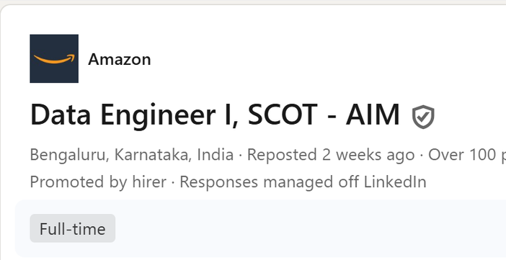
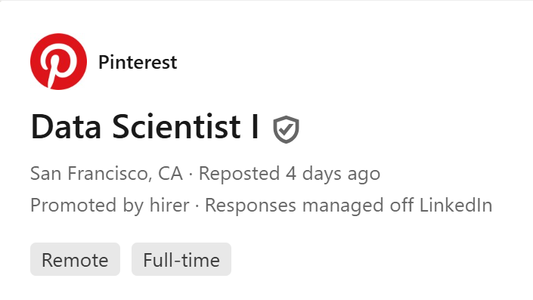
Missing Work Types
While scraping job posts from LinkedIn:
Some job posts did not specify a work type(remote, hybrid, onsite) — even on the original LinkedIn page.
had no explicit mention of work_type
Why I didn't fill them manually:
After reviewing several of these jobs, I noticed that:
Some companies decide work type later, based on candidate location or experience level.
Other roles were listed as "open to discussion" or "flexible".
Decision:
Kept the work_type as (Unspecified) to reflect real-world ambiguity.
This avoids making incorrect assumptions and keeps the data truthful and unbiased.

Slide 7
Key Dashboard Elements :
Job Roles Distribution:
Top demanded roles (e.g., Data Analyst, Data Scientist, ML Engineer)
Work Type Breakdown :
On-site vs Remote vs Hybrid vs Unspecified
Geographic Distribution :
Jobs by country (mapped using cleaned location data)
Employment Type : Full-time, Contract, Internship, etc.
Top Hiring Companies : Companies with highest number of listings

Slide 8
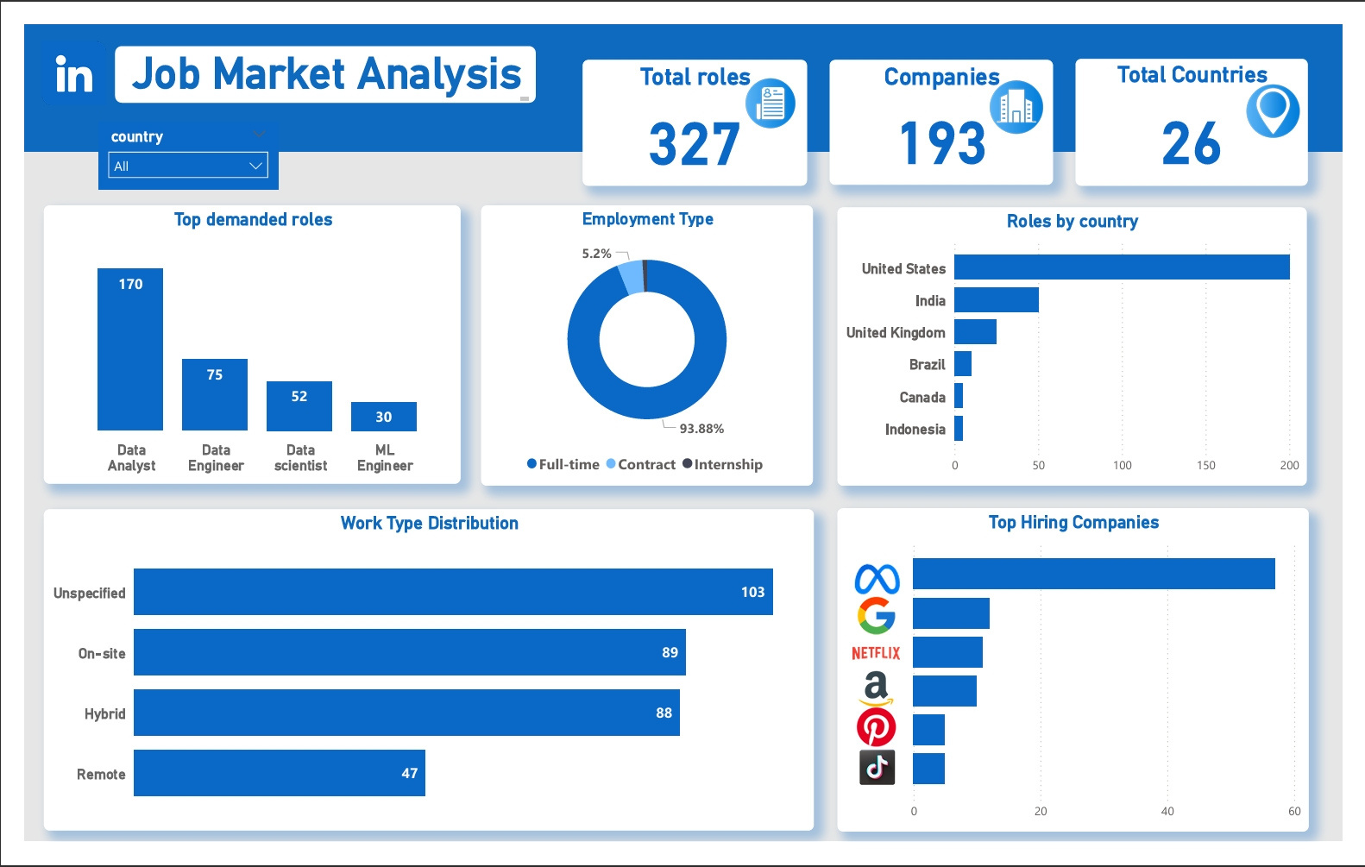

Slide 9
THANK YOU

